Slide 1
Data Persistence
STW300CEM Android Application Development

Slide 2
Topics to cover
File Handling
Shared Preferences
SQLite

Slide 3
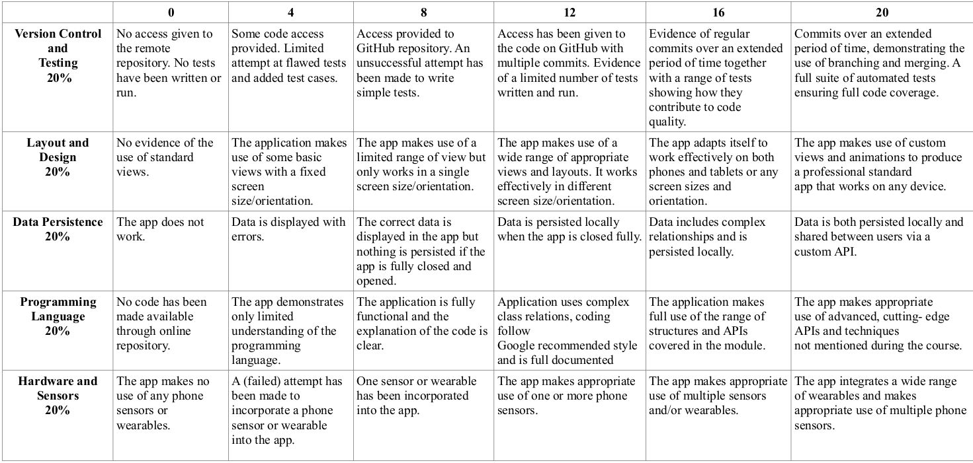
Final Assignment Marking Ruberic

Slide 4
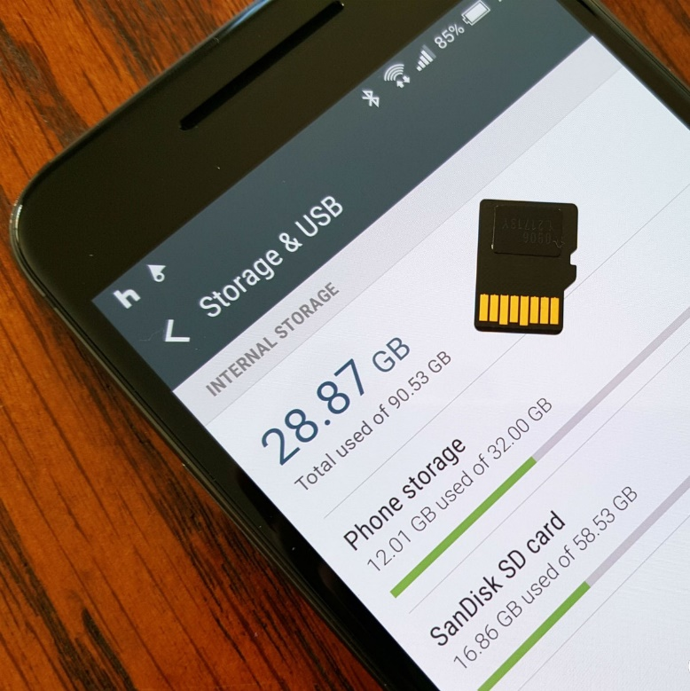
1. Android Storage
Android can read/write from two locations :
Internal
External
Both are persistent; data remains after power-off/reboot.
Internal storage : Built into the device
External storage : An SD card or other device attached to device.
An app can be installed into either area.

Slide 5
Internal vs External Storage
Internal storage | External storage
It's always available. | It's not always available, because the user can mount the external storage as USB storage and in some cases remove it from the device.
Files saved here are accessible by only your app. | It's world-readable, so files saved here may be read outside of your control.
When the user uninstalls your app, the system removes all your app's files from internal storage. | When the user uninstalls your app, the system removes your app's files from here only if you save them in the directory from getExternalFilesDir().
Internal storage is best when you want to be sure that neither the user nor other apps can access your files. | External storage is the best place for files that don't require access restrictions and for files that you want to share with other apps or allow the user to access with a computer.

Slide 6
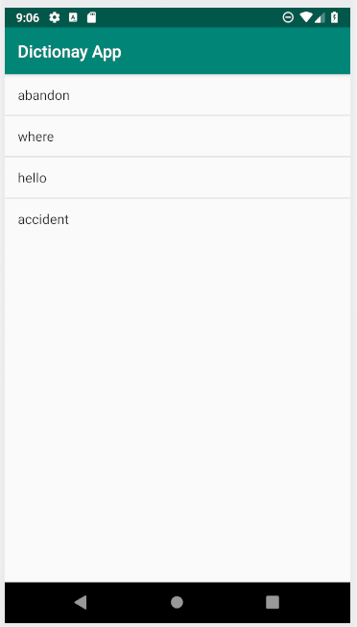
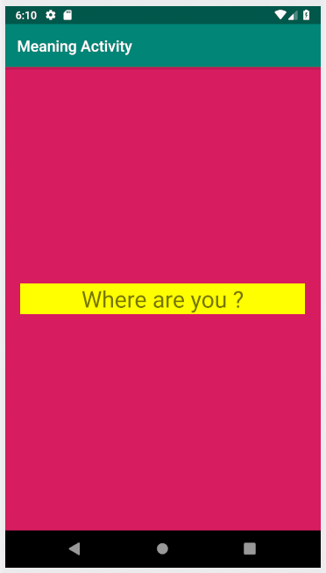
Back to Dictionary App

Slide 7
Design
Design is same as before. Refer Topic 4.

Slide 8
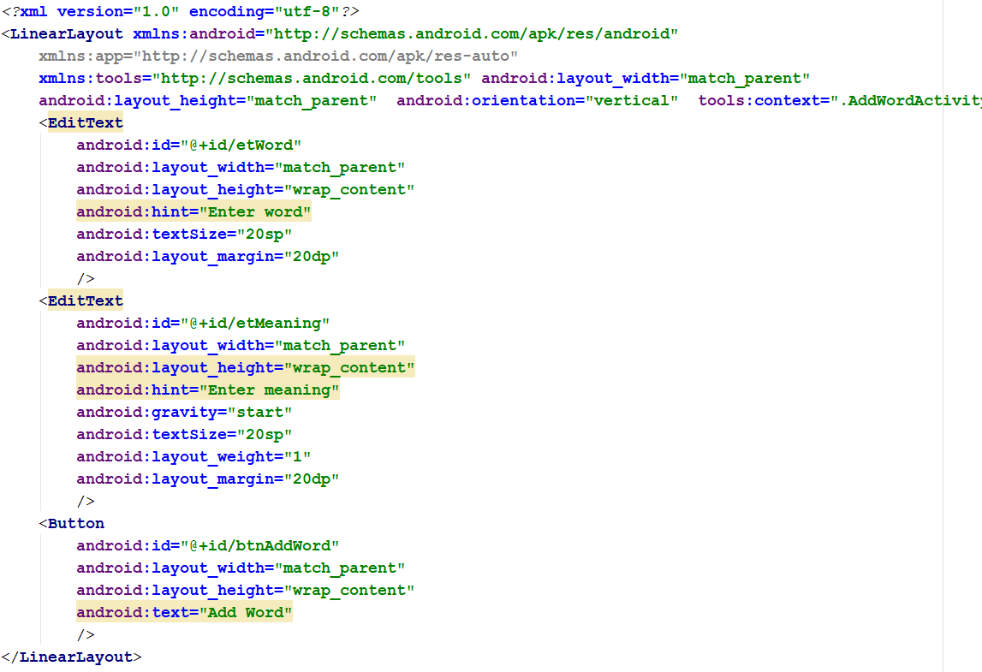
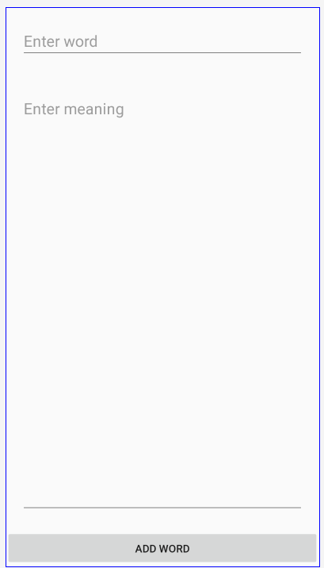
AddWord Activity

Slide 9
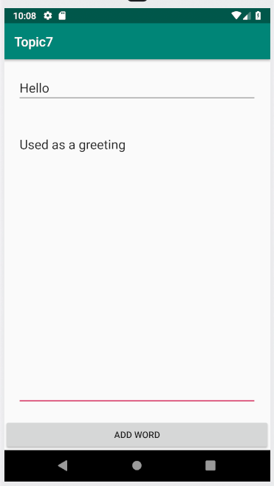
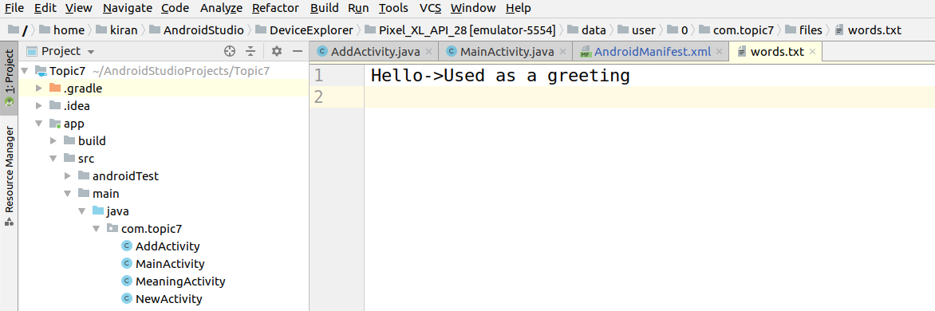
-> is used to seperate word and meaning

Slide 10
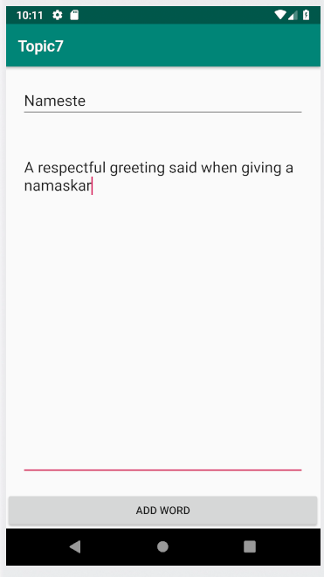
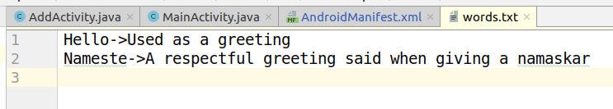
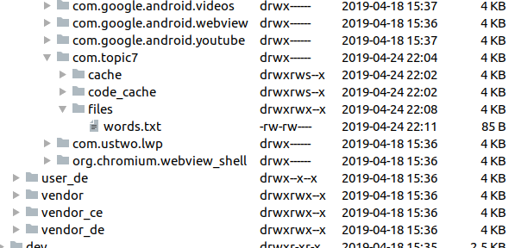
To check the txt file click Device File explorer -> data -> user -> 0
-> <<Your app name >> -> files

Slide 11
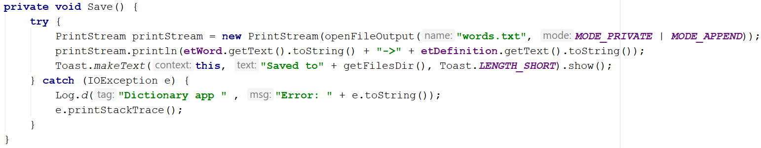
Write a new file

Slide 12
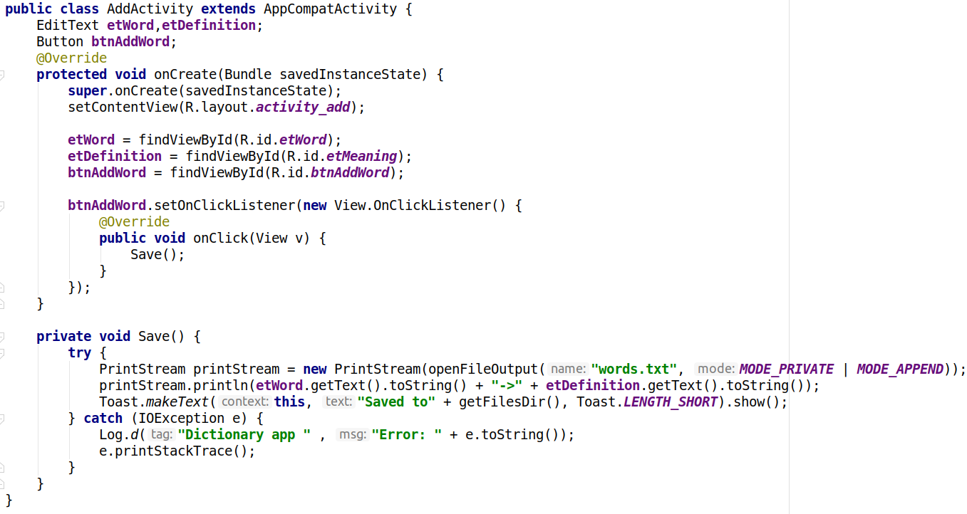
Add word Activity

Slide 13
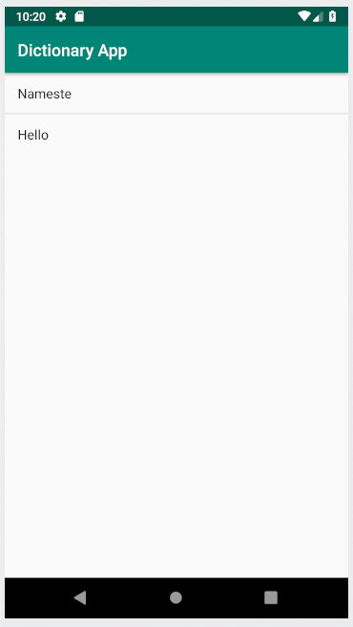
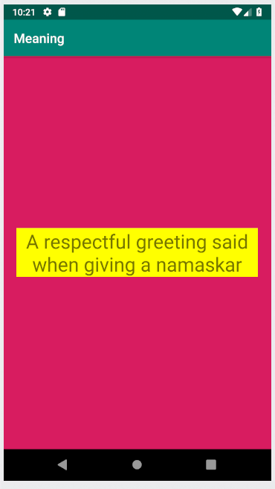

Slide 14
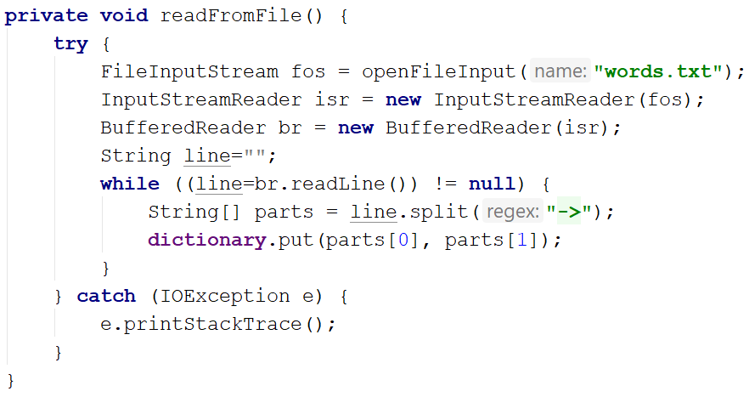
Read From File
Key
Value
Add to HashMap
Key
Value
Notes:
InputStreamReader : is a bridge from byte streams to character streams. It reads bytes and decodes them into characters using a specified charset.

Slide 15
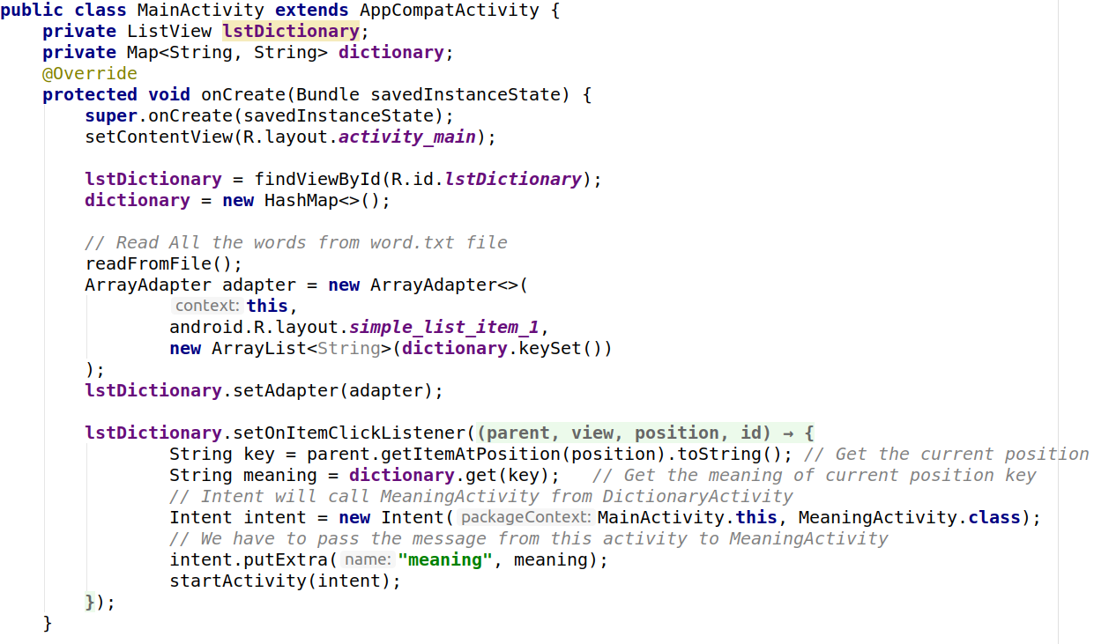
Main Activity

Slide 16
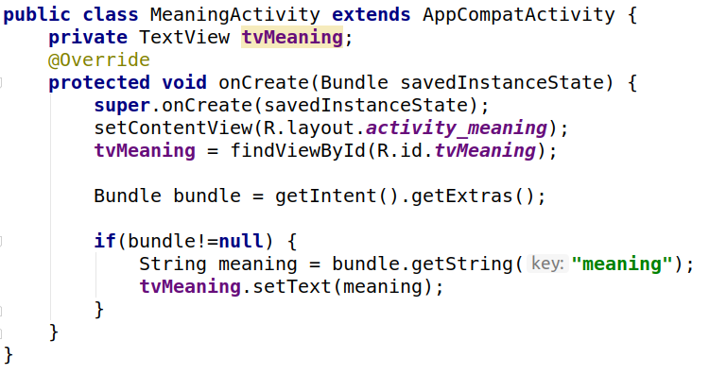
Meaning Activity

Slide 17
Intent
Implicit Intent
Explicit Intent

Slide 18
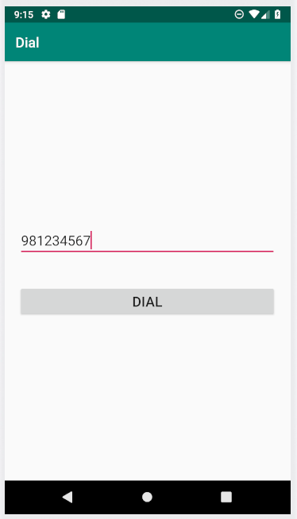
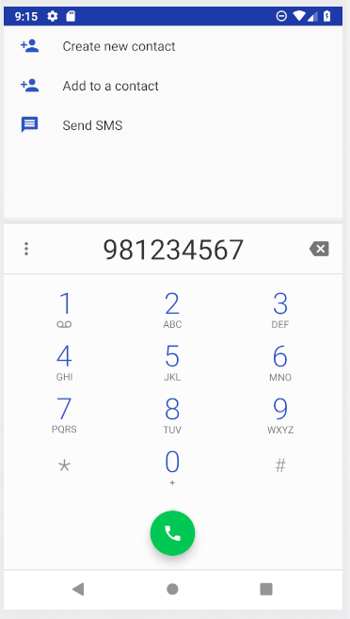
Implicit Intent
Open Dialer App

Slide 19
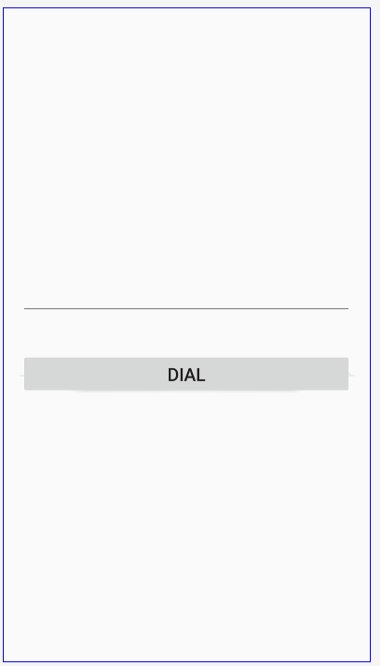
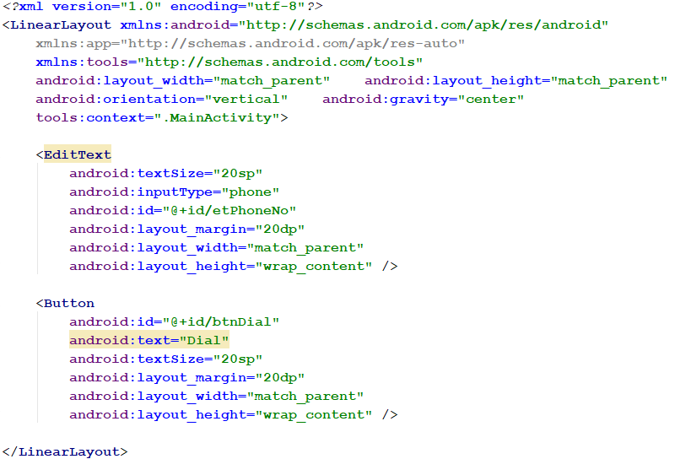
XML

Slide 20
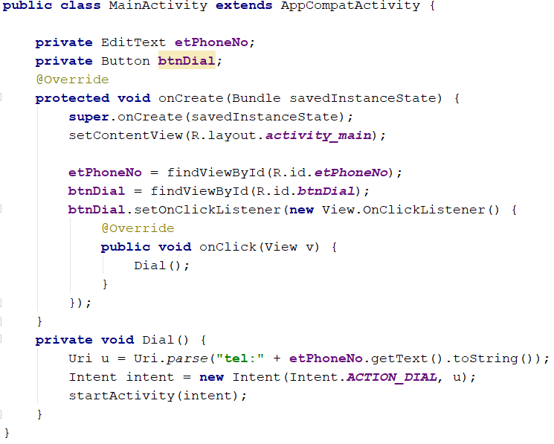
Code
The 'tel:' prefix is required
ACTION_DIAL doesn't require any permission.

Slide 21
User Permissions
The purpose of a permission is to protect the privacy of an Android user. Android apps must request permission to access sensitive user data (such as contacts and SMS), as well as certain system features (such as camera and internet).
Depending on the feature, the system might grant the permission automatically or might prompt the user to approve the request.
A central design point of the Android security architecture is that no app, by default, has permission to perform any operations that would adversely impact other apps, the operating system, or the user.
This includes reading or writing the user's private data (such as contacts or emails), reading or writing another app's files, performing network access, keeping the device awake, and so on.

Slide 22
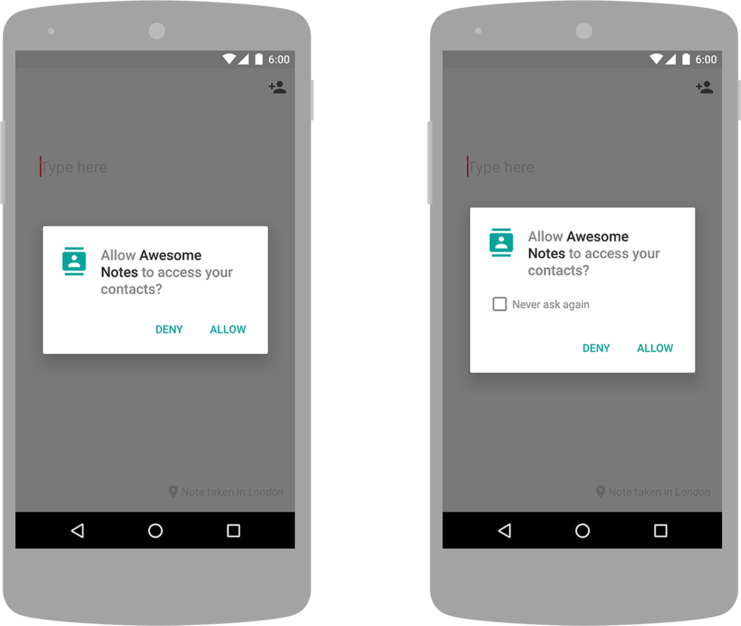
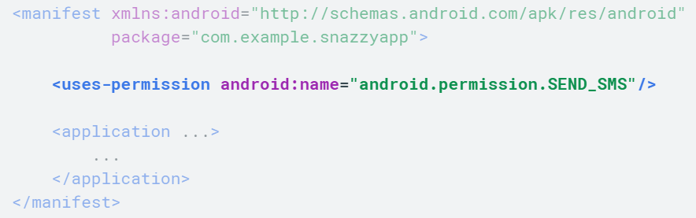
User Permissions

Slide 23
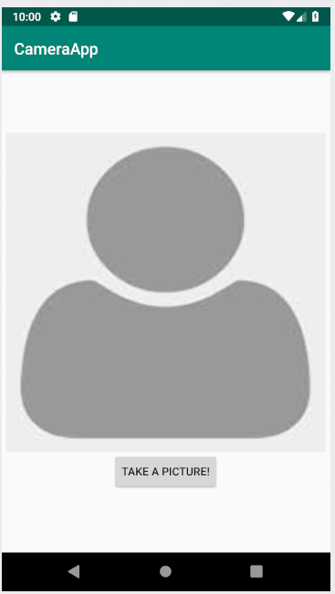
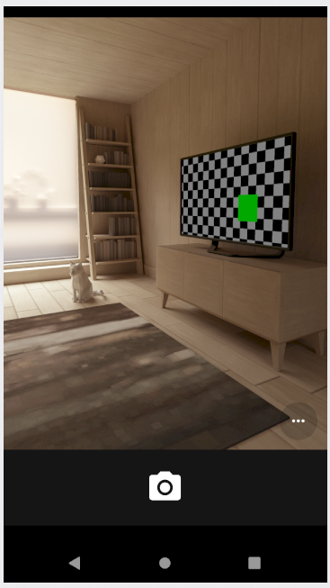
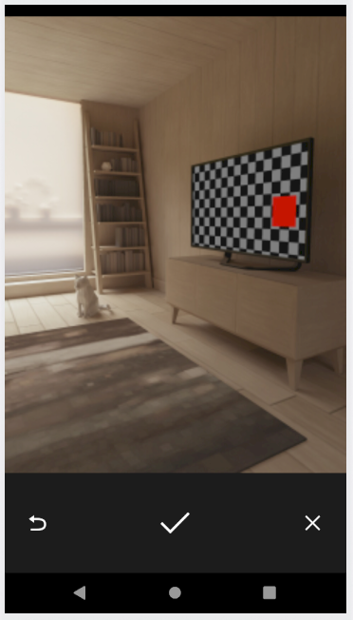
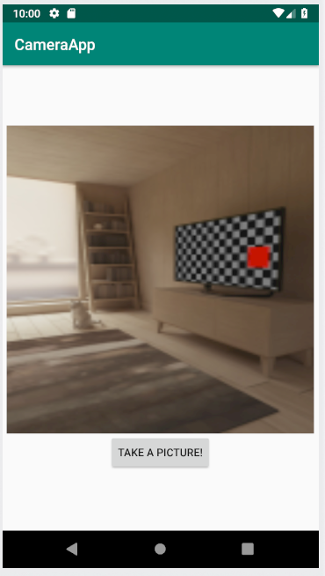
Opening a camera app and take photo

Slide 24
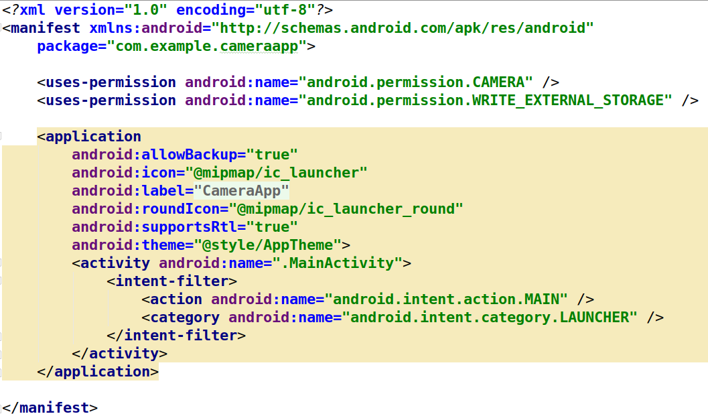
Add Permissions in Manifest.xml

Slide 25
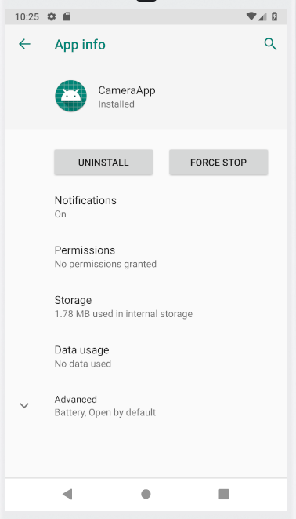
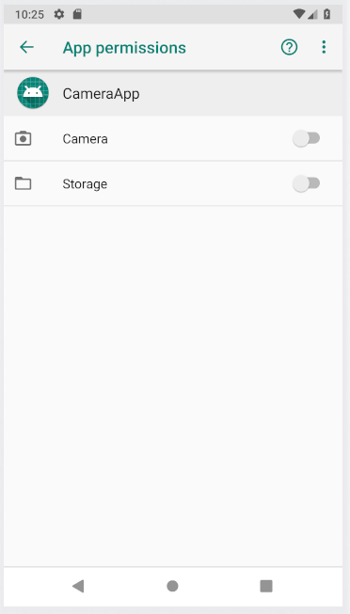
By Default permissions are
disabled.

Slide 26
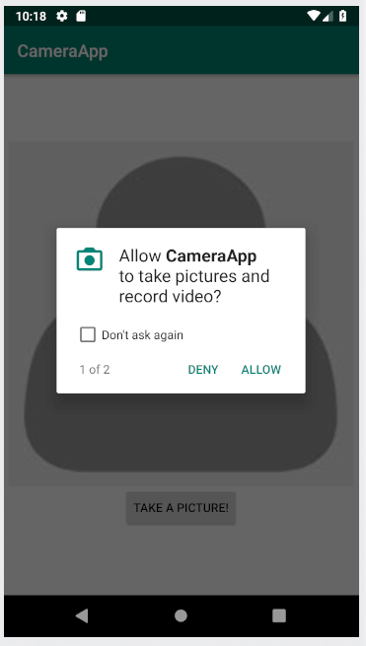
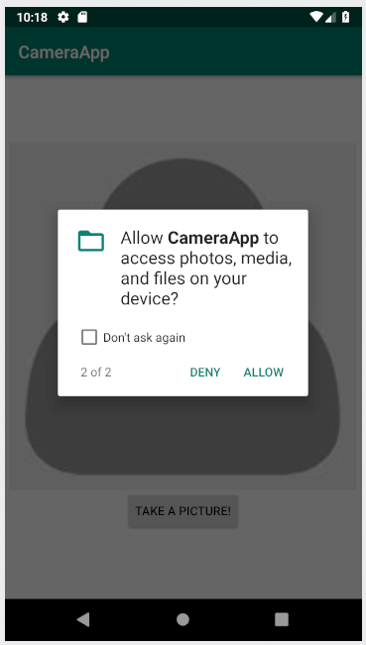
Runtime permissions

Slide 27
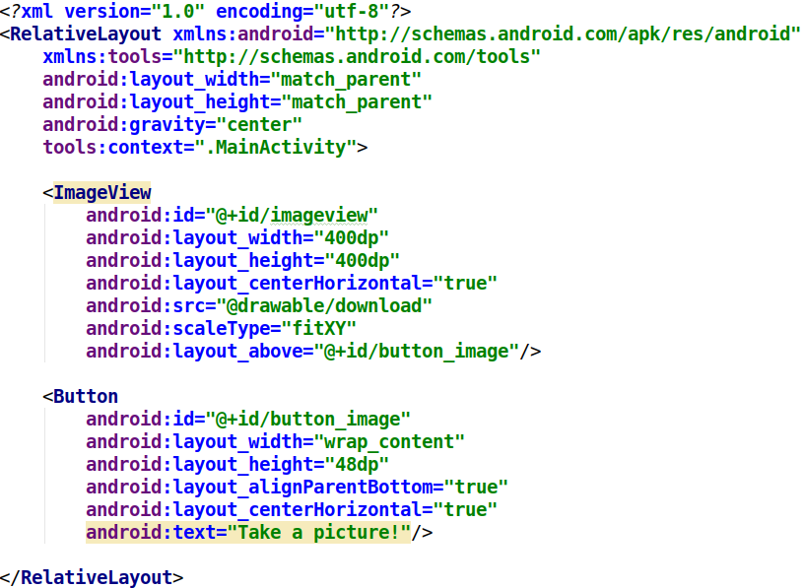
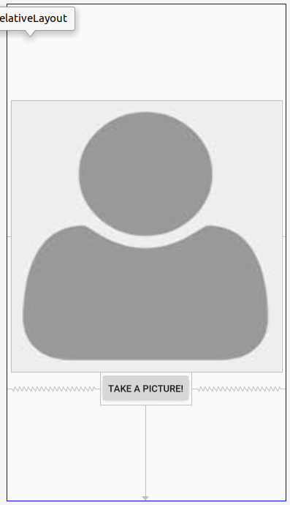
XML file

Slide 28
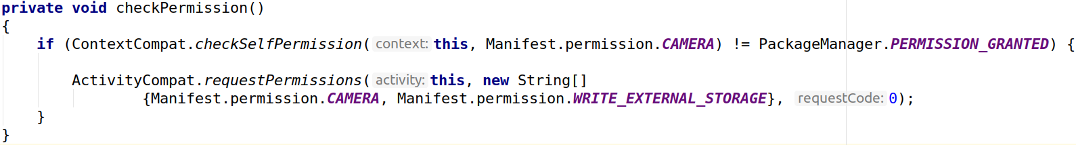
Check for permissions
Check weather the application has camera permissions or not ?

Slide 29
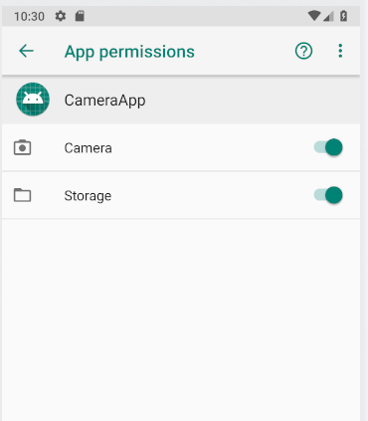
After allowing

Slide 30
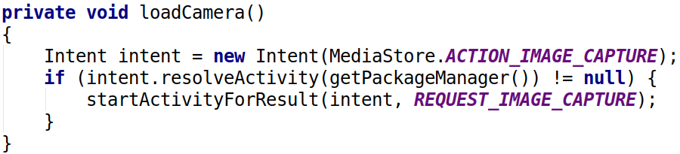
Load Camera
To first verify that an app exists to receive the intent,
call resolveActivity() on your Intent object.
Notes:
To first verify that an app exists to receive the intent, call resolveActivity() on your Intent object.

Slide 31
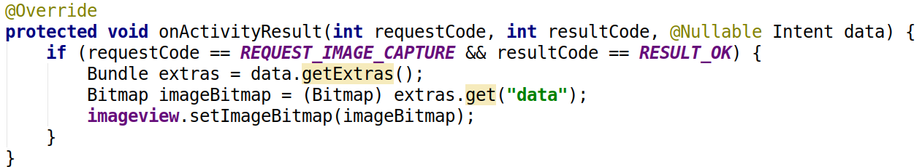
Getting Image from camera to Main Activity
press ctrl + o and override onActivityResult

Slide 32
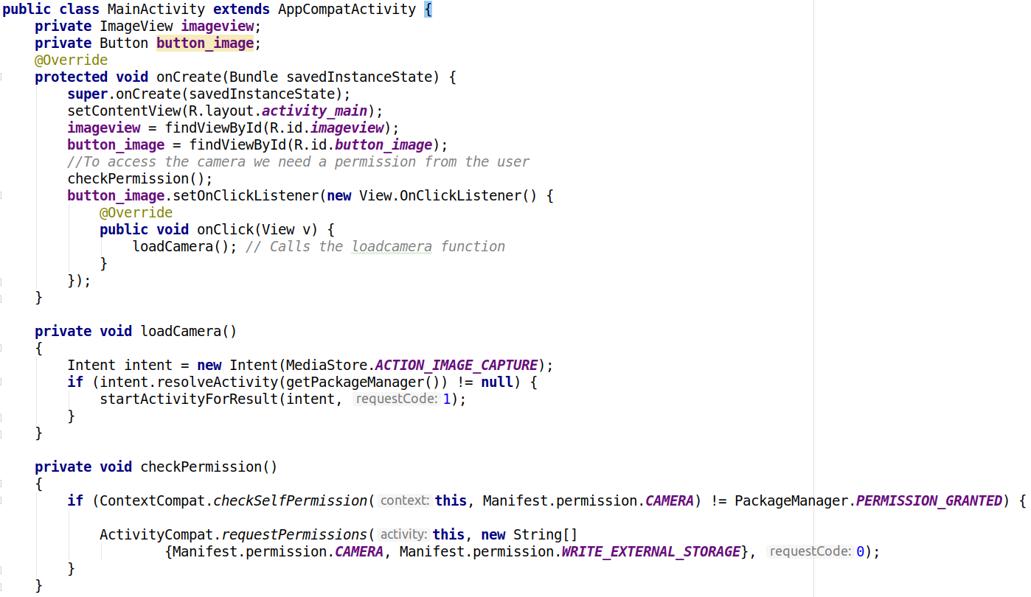

Slide 33
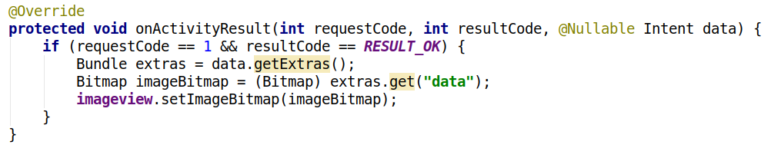
contd..

Slide 34
Class work
Save the lmageview image to SD Card.

Slide 35
2. SharedPreferences
Android provides many ways of storing data of an application. One of this way is called Shared Preferences.
Shared Preferences allow you to save and retrieve data in the form of key, value pair.
It stores only primitive data types data i.e. Boolean , float , int , longs and strings.
Data is stored in xml file .
It is mainly used for storing username and password , settings etc.

Slide 36
Get a handle to shared preferences
You can create a new shared preference file or access an existing one by calling one of these methods:
1. getSharedPreferences() :
Use this if you need multiple shared preference files identified by name, which you specify with the first parameter. You can call this from any Context in your app.
2. getPreferences() :
Use this from an Activity if you need to use only one shared preference file for the activity. Because this retrieves a default shared preference file that belongs to the activity, you don't need to supply a name.

Slide 37
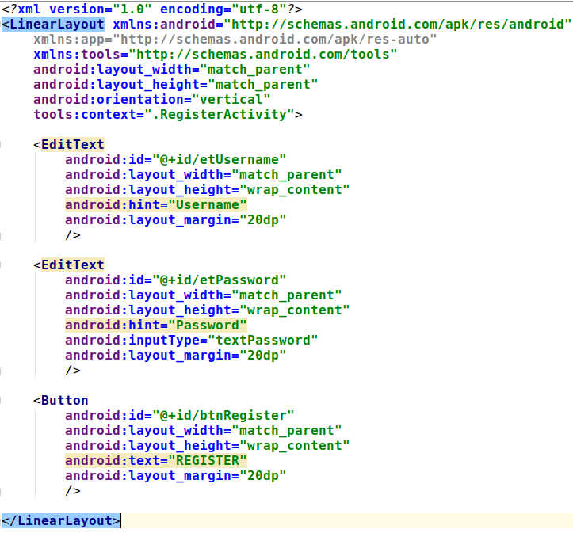
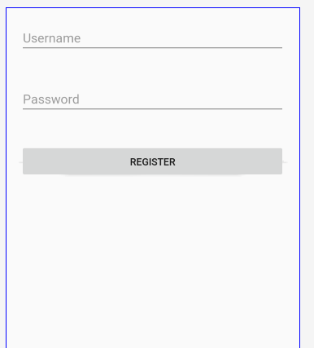
XML

Slide 38
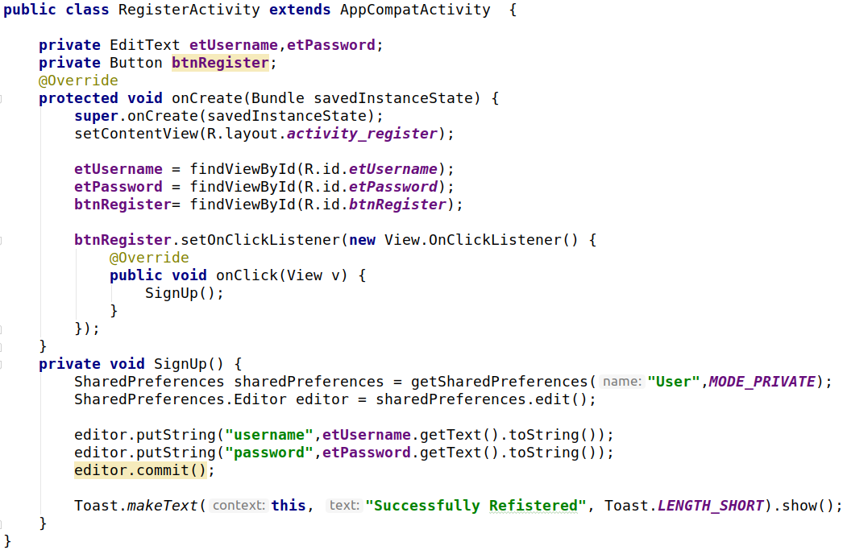

Slide 39
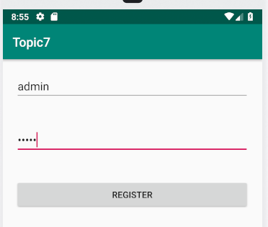
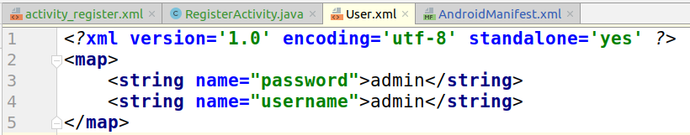
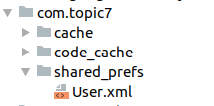
data/data/<<your app name>>/shared_prefs

Slide 40
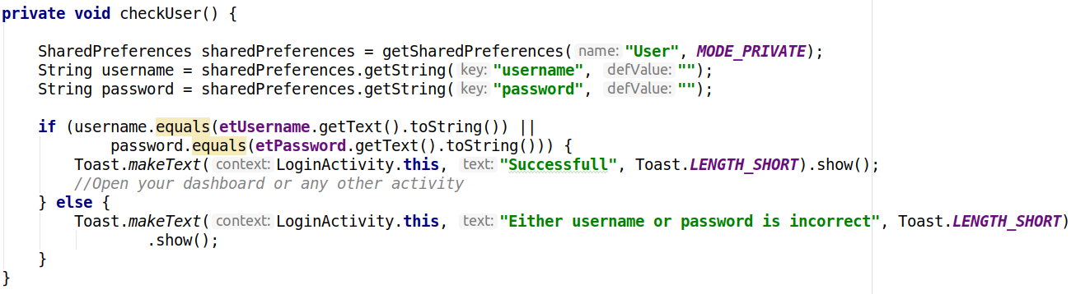
Reading from SharedPreferences

Slide 41
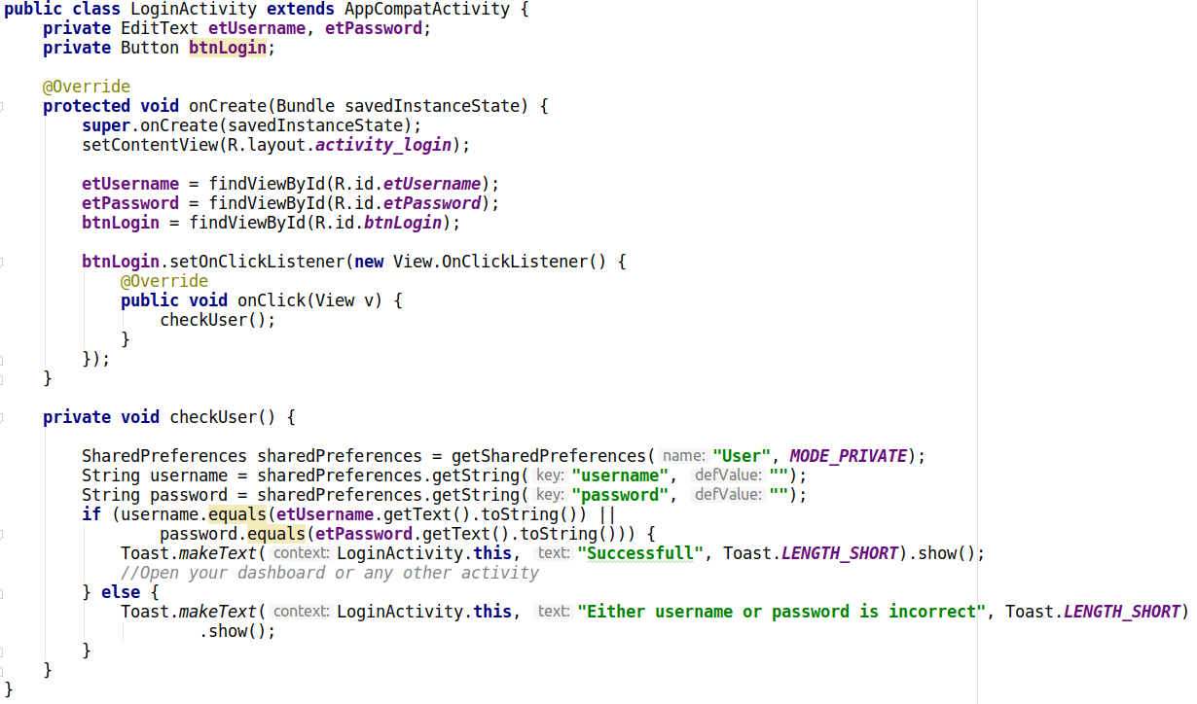
Login Activity

Slide 42



getDefaultSharedPreferences
No need to give the name of SharedPreferences . It will search
For the default shared prefs

Slide 43

Splash Screen
A splash screen is a graphical control element consisting of a window containing an image, a logo, and the current version of the software.
A splash screen usually appears while a game or program is launching.

Slide 44


XML

Slide 45

Code

Slide 46

3. SQLite
SQLite is a relational database management system contained in a C programming library.
In contrast to many other database management systems,SQLite is not a client-server database engine.Rather, it is embedded into the end program.
SQLite is ACID-compliant and implements most of SQL standard.
SQLite uses a dynamically and weakly types SQL syntax that does not gurantee the domain integrity.

Slide 47

Datatypes in SQLite
TEXT
NUMERIC
INTEGER
REAL
BLOB

Slide 48
Steps to create database in SQLite
Inherit SQLiteOpenHelper
onCreate() method
onUpgrade() method

Slide 49


XML

Slide 50


1. Create MyHelper Class

Slide 51

2. Create a Constructor and Fields for a table
Table Name
Columns

Slide 52

3. Create a table (MyHelper class)

Slide 53

MyHelper Class

Slide 54


Main Activity
Device File Explorer -> Data -> Data -> << your app name >>
This function will call MyHelper constructor and creates
the database and also calls the OnCreate()

Slide 55

4. Inserting data in Database(MyHelper class)

Slide 56

Inserting using Content Values
ContentValues is a name value pair, used to insert or update values into database tables.
ContentValues object will be passed to SQLiteDataBase objects insert() and update() functions.

Slide 57

4. Inserting data in Database (Another method)
Problem here is we cannot see all the
Tables and data.

Slide 58

5. Passing values to InsertData()
If successfully inserted then it will return the
Id (which is int value). If error occurs it will return
-1

Slide 59
Install DBBrowser for SQLite
For Mac and Windows :
https://sqlitebrowser.org/dl/
For linux :
sudo apt-get update
sudo apt-get install sqlitebrowser

Slide 60



Save Database in a folder
Select a location to save database
2
1
3
After saving

Slide 61


Open DBBrowser
1
2

Slide 62



Open DBBrowser
3
4
5

Slide 63

Retrieving data from database
Cursor is the Interface which represents a 2 dimensional table of any database.
When you try to retrieve some data using SELECT statement, then the database will first create a CURSOR object and return its reference to you.
moveToFirst()
moveToNext()

Slide 64


Retrieving data from database
This function will return List of Word
OR

Slide 65

Word Class
Create a model namespace and
create Word.java class

Slide 66


Create another Activity for displaying words from SQLite

Slide 67

DisplayWord Activity

Slide 68

Output

Slide 69


Search Word by Name
OR

Slide 70
Class Work
Display Definition in another activity.

Slide 71


Updating Data
OR

Slide 72

Deleting Data

